Slide 1
Why do migrating TJs suddenly start erupting large volumes of MORB?

Slide 2
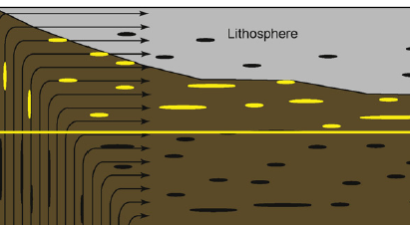
UPDATE OF CLASSICAL PHYSICS-BASED PLATE MODELS (Birch, Elsasser, Uyeda, Hager…)*
Ocean Island
LITHOSPHERE
INSULATING LID
MORB
LVZ
OIB
220 km
MORB
after Hirschmann
-200 C
-200 C
See also Doglioni et al., On the shallow origin of hotspots…: GSA Sp. Paper 388, 735-749, 2005.
*not Morgan, Schilling, Hart, DePaolo, Campbell…
Notes:
8. The amount of melt in the LVZ is too small to explain the wavespeed and the anisotropy (Hirschmann, 2010) unless the temperature is ~200 K in excess of MORB temperatures, about the same as required to explain Hawaiian tholeiites. This suggests that within-plate volcanoes are sampling ambient BL mantle, as suggested by Carlo Doglioni and others.

Slide 3
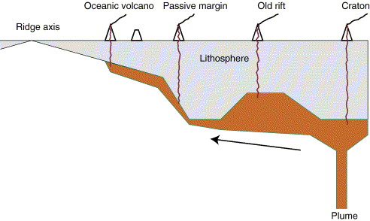
Standard Model
MORB
“ambient”
Ridge source
hot
Norman Sleep
Jason Phipps Morgan
Long-Distance Lateral flow of plume material…avoiding thin spots (ridges)
Lateral plumes
+200 C
LLAMA Boundary (thermal bump) Layer (thick plate)Model
Ridge
anisotropic
hot
-200 C
Sub-
Adiabatic
3D Passive Upwellings
See “shallow origin of hotspots…”, C. Doglioni
Ridge source
Notes:
14. Morgan and Sleep (upper panel) have recently decoupled vertical plumes from surface hotspots by invoking long distance lateral flow
of plum pudding mantle. In the plate and boundary layer models (lower panel), passive upwellings feed ridges directly or by along-ridge and lateral flow, below the boundary layer.

Slide 4
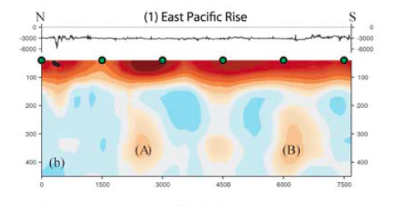
THE QUESTION NOW IS, WHERE DOES MORB COME FROM?
RIDGES HAVE DEEP FEEDERS
Some ridge segments are underlain by “feeders” that can be traced to >400 km depth, particularly with anisotropic tomography (upwelling fabric)
Only ridge-related swells have such deep roots
6:1 vertical exaggeration
Ridges are cold & cannot represent ambient midplate or back-arc mantle
Maggi et al.
Notes:
17. Some ridge segments are underlain by “feeders” that can be traced to >400 km depth, particularly with anisotropy (upwelling fabric). The feeders, with no vertical exaggeration, are dome-like.

Slide 5
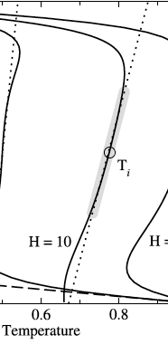
RIDGE FEEDERS
Along-ridge profile
True intra-plate hotspots do not have deep feeders
R i d g e
geotherms
TZ
Ridge adiabat
ridge
Ridge-normal profile
OIB
TZ
T
Notes:
19. Schematic model based on surface wave tomography (anisotropy & wave speeds). On-ridge and off-ridge dome-like upwellings feed ridges.The long distance lateral sub-plate flow (Sleep) applies also to the feeding of ridges by passive upwellings (Vogt).

Slide 6
RIDGE FEEDERS
Along-ridge profile
True intra-plate hotspots do not have deep feeders
R i d g e
TZ
ridge
Ridge-normal profile
OIB
TZ
Notes:
19. Schematic model based on surface wave tomography (anisotropy & wave speeds). On-ridge and off-ridge dome-like upwellings feed ridges.The long distance lateral sub-plate flow (Sleep) applies also to the feeding of ridges by passive upwellings (Vogt).

Slide 7
SUMMARY
Net W-ward drift is an additional source of shear (no plate is stationary)
ridge
LID
LVZ
LLAMA
200
400
km
Mesosphere (TZ)
Cold slabs
Ridges are fed by broad 3D upwellings plus lateral flow along & toward ridges
Intraplate orogenic magmas (Deccan, Karoo, Siberia) are shear-driven from the 200 km thick shear BL (LLAMA)
Notes:
25 (22). The transition zone feeds ridges. Cold slabs accumulate at 650 km, displacing older mantle upwards. (The geometry, enriched over depleted but fertile, is the reverse of the WOOD’s HOLE
(Schilling/Hart/Hauri/Hanan/Jackson) geochemical models). “Hotspots” are side effects of plate tectonics.

Slide 8
Map view
depths
400 km
deep
Broad upwellings from MORB source
Background
200 km depth
400 km
deep
200
km
ridge
Notes:
Map view of subplate mantle showing (in pink) along ridge flow and lateral flow from TZ upwellings

Slide 9
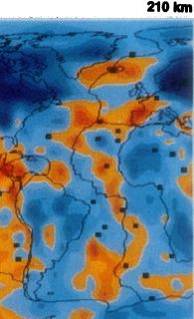
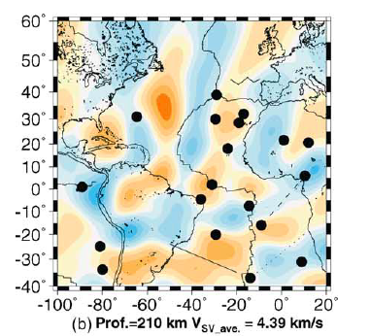
Notes:
Silveira and Stutzmann (2002) FIGURE 4
Fig. 3. S-wave velocity lateral variations with respect to the
average value written at the bottom on each plot for depths:
(a) 110 km; and (b) 210 km depth; (c) plate boundaries, hot
spot locations and some geological features-after Crough (1983).

Slide 10
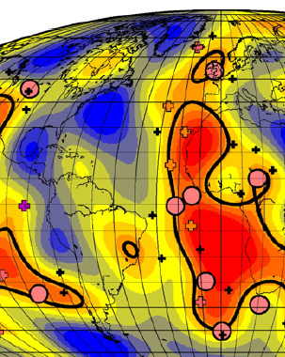
More hotspots on the Atlantic and Nazca plates are concentrated along the edges of the upper mantle LVAs than along the edges of the lower mantle LLVSPs and the area occupied by the hotspots corresponds more closely to the area of the anomalies, meaning that there is a much lower probability of this occurring by chance.
Notes:
Silveira and Stutzmann (2002) FIGURE 4
Fig. 3. S-wave velocity lateral variations with respect to the
average value written at the bottom on each plot for depths:
(a) 110 km; and (b) 210 km depth; (c) plate boundaries, hot
spot locations and some geological features-after Crough (1983).

Slide 11
Notes:
Burke

Slide 12
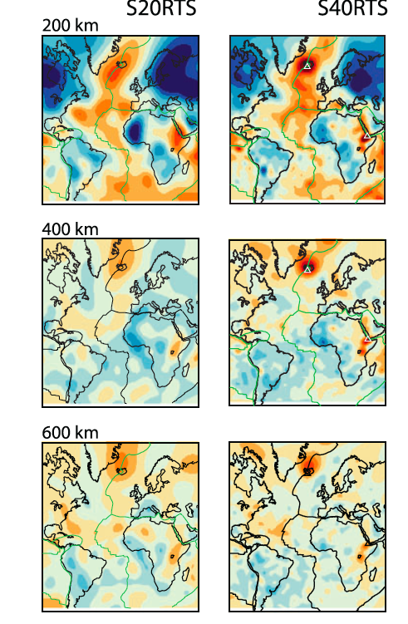
Notes:
Geophys. J. Int. (2010) doi: 10.1111/j.1365-246X.2010.04884.x
GJI Seismology
FIGURE 9
S40RTS: a degree-40 shear-velocity model for the mantle from new
Rayleigh wave dispersion, teleseismic traveltime and normal-mode
splitting function measurements
J. Ritsema,1 A. Deuss,2 H. J. van Heijst3 and J. H. Woodhouse3

Slide 13
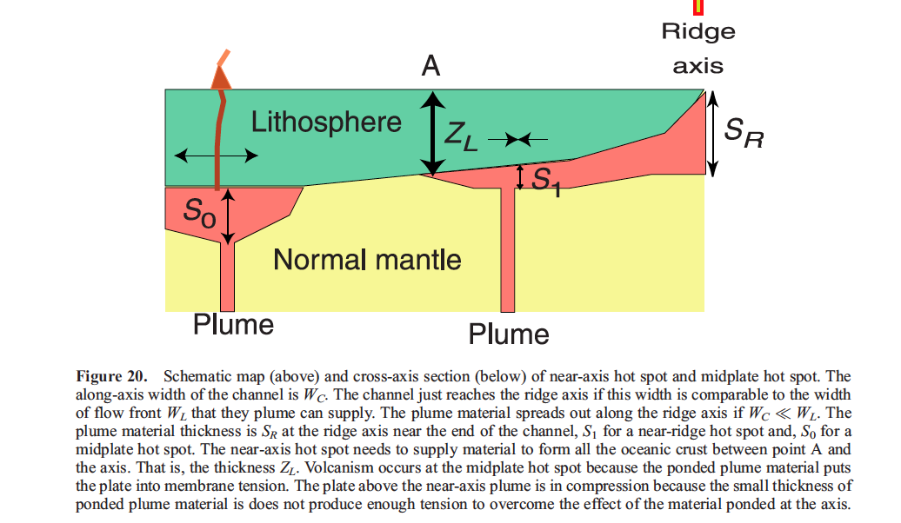
MORB MORB

Slide 14
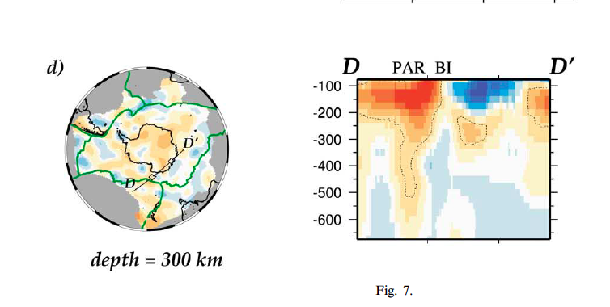
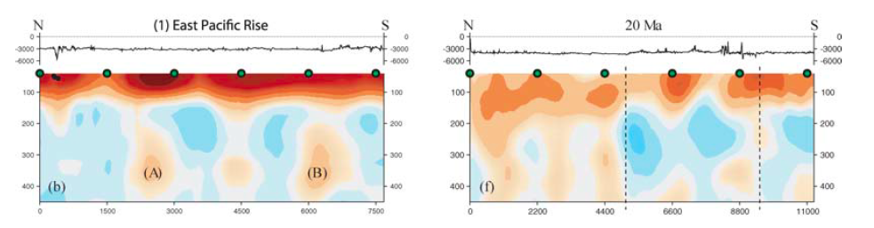

Slide 15
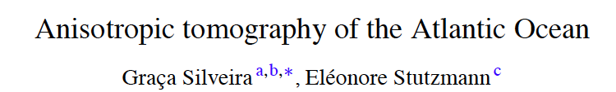
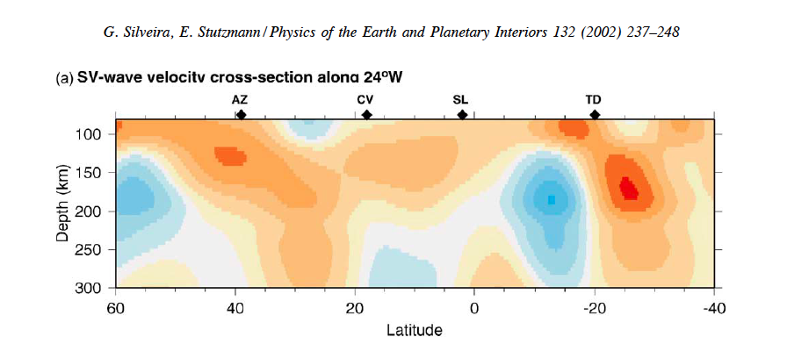
Notes:
Silveira and Stutzmann (2002) FIGURE 4

Slide 16
INVERTED GEOTHERMS
27
HAWAII
MORB
BOUNDARY LAYERS TURNING HORIZONTAL,
INSULATION
HEATING WHILE RISING
(Internal heating of passive upwellings)
SUBDUCTION &
SECULAR COOLING
(cooling from below)
Jeanloz, Morris, Butler, Sinha
Subadiabaticity explains high gradients of seismic velocity below ~200-km depth & both MORB & Hawaii temperatures

Slide 17
Boundary layer convection
Cooled from above
pull
2898 km
VS
650 km
slabs
push
Heated from the core (standard or canonical models, CIDER bottom up anchor model)
…and below
plus thermal overshoot, subadiabaticity…
…plus Kelvin effect, radioactivity & classical physics
Broad dome
CMB
Opposite of CIDER bottom up models (UCB, Harvard)

Slide 18
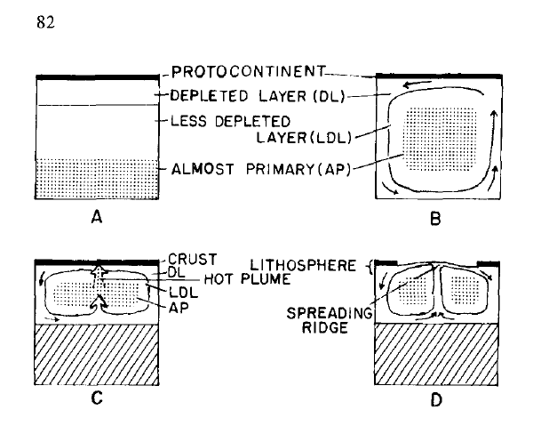
Notes:
Tats

Slide 19
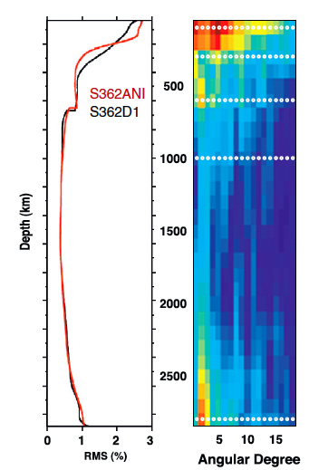
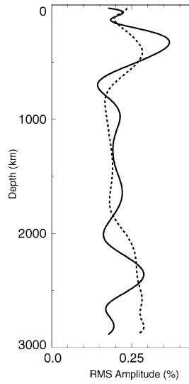
Layered, boundary layer, top down (anti-anchor hypothesis)
Boundary Layer Melange
Active layer
Slabs at 650 km
(Degree 2 pattern)
density
Too dense to rise
UNCORRELATED
Degree 2
Domes at CMB
Ishii & Tromp

Slide 20
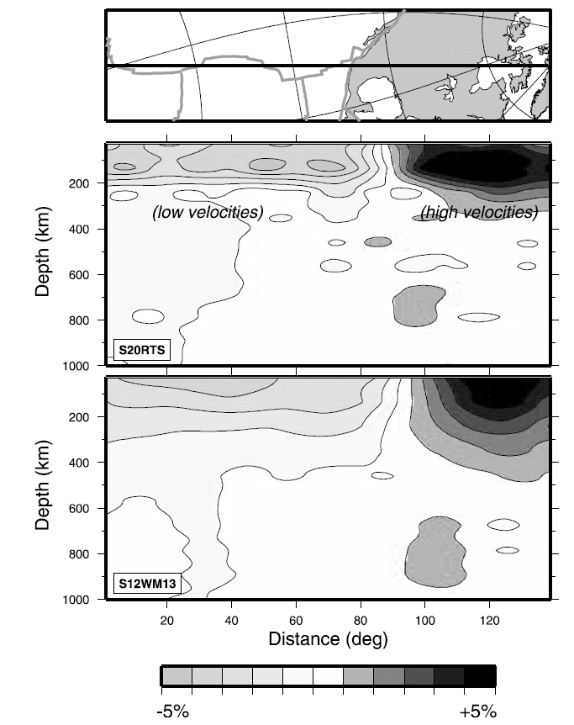
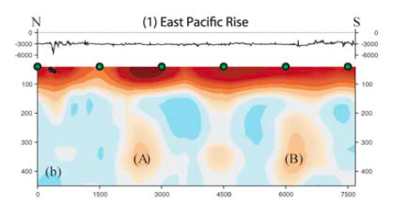
Velocity anomalies & anisotropy change abruptly at 220 km
REGION B
EPR
Deep (TZ) ridge feeders
Ritsema et al., 2004
Maggi et al.

Slide 21
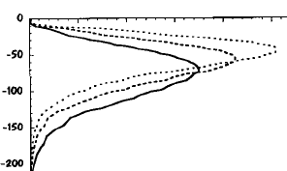


Thus, the ‘new’* Paradigm
Shear-driven magma segregation
Shear strain
Super-adiabatic boundary layer
REGION B
Hawaii source
“fixed”
300 km
Thermal max
Tp decreases with depth
Narrow downwellings
cooling the mantle
Broad passive upwellings
MORB source
TRANSITION ZONE (TZ)
600 km
600 km
(RIP)
200 Myr of oceanic crust accumulation
(* actually due to Birch, Tatsumoto, J. Tuzo Wilson)
Notes:
20. The plate tectonic cycle in a mantle that is internally heated and cooling with time. Convection is composed of narrow downwellings and broad upwellings, the precise opposite of Morgan’s & Schilling’s assumptions and subsequent geochemical models.
Region B is a sheared BL with a superadiabatic thermal gradient and decreasing seismic wavespeeds. Most of the underlying mantle has a subadiabatic gradient, giving high positive wavespeed gradients. Cold upwellings, triggered by spreading and subduction, can originate in the transition region because of the subadiabatic nature of the geotherm and the cooling effect of slab trapping by the 650-km discontinuity.

Slide 22
eclogite
harzburgite
410
cold
650
cold

Slide 23
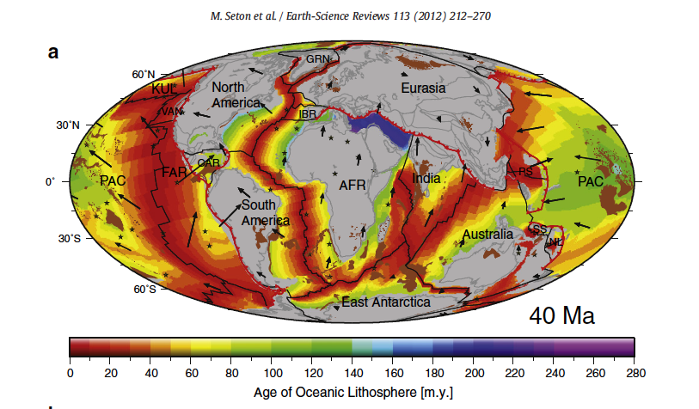
Pacific hotspots & backtracked plateaus
Indian Ocean hotspots & plateaus
Atlantic hotspots
Present day ridge-related low wavespeed regions correspond to red-brown age regions & backtracked ‘hotspots’
4:50

Slide 24

Ridges and hotspots
& backtracked LIPs
J.Tuzo Wilso first noted the ridge-hotspot connection; this is even more remarkable at depth (100-200 km)
Notes:
There are about 8 hotspots that are remote from plate boundaries…or are not underlain by ridge-like LVAs.
At least 14 hotspots overlie mantle that is clasified as ‘ridge-like’ by Ritsema and Allen. These include some that are not technically on ridges
from a surface tectonic point of view. 4.33-4.4 km/s 1.6 % low, 4.23-4.4 -3.9 % low about 9 outside…
Furthermore, we identify an anomalous oceanic
region characterized by slow shear wave speeds at depths below 150 km. Hotspots are found preferentially in
the vicinity of this anomalous region. In the Pacific Ocean, where plate velocities are largest, these regions
have elongated shapes that align with absolute plate motion, suggesting a relationship between the location
of hotspots and small-scale convection in the oceanic upper mantle.
V. Lekic, B. Romanowicz / Earth and Planetary Science Letters 308 (2011) 151–160

Slide 25
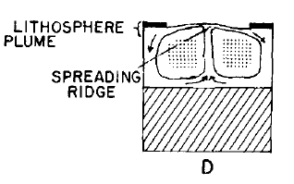

Slide 26
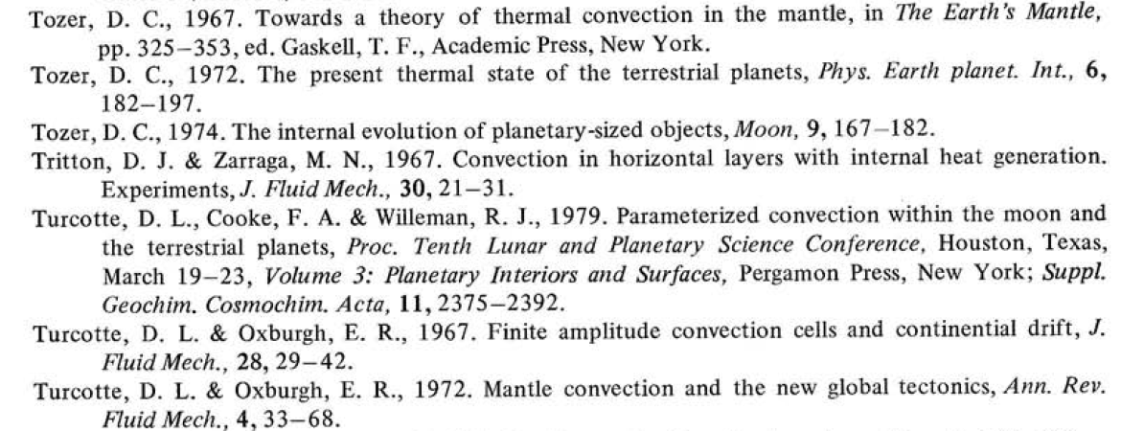

Slide 27
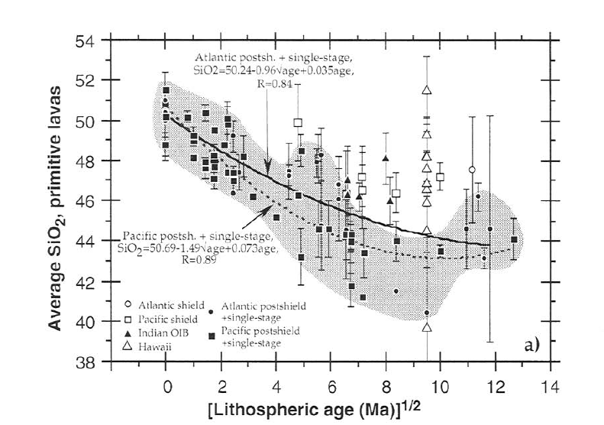
Notes:
Haase

Slide 28
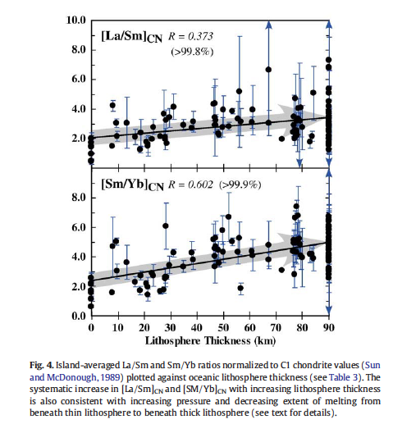
Notes:
Humphreys and Niu
MORB-like signature gone by 40 km thick plate

Slide 29
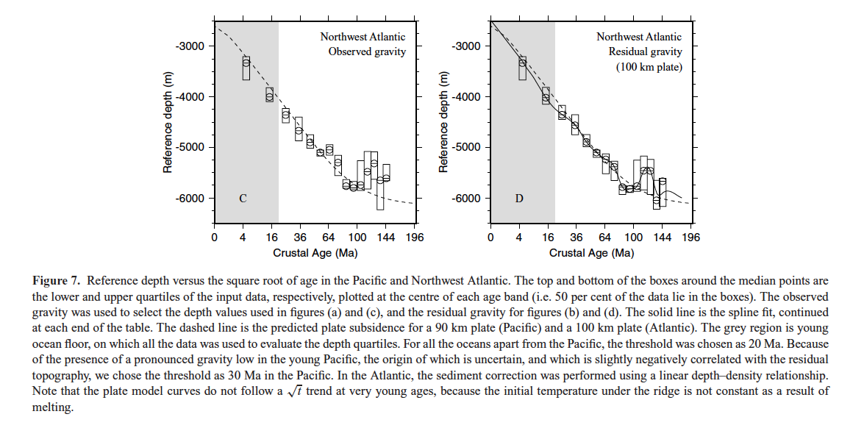
Notes:
The mantle that is under oceanic crust that is younger than 30 Ma on average differs from that under older crust (geochemistry, isotopes, major elements, flattening, gravity-topo correlation…) and this is attributed to deep passive upwellings…The grey region is young ocean floor, on which all the data was used to evaluate the depth quartiles. For all the oceans apart from the Pacific, the threshold was chosen as 20 Ma. Because
of the presence of a pronounced gravity low in the young Pacific, the origin of which is uncertain, and which is slightly negatively correlated with the residual topography, we chose the threshold as 30 Ma in the Pacific. In the Atlantic, the sediment correction was performed using a linear depth–density relationship.
Note that the plate model curves do not follow a√t trend at very young ages, because the initial temperature under the ridge is not constant as a result of
melting.
The relationship between depth, age and gravity in the oceans
G. Crosby,1 D. McKenzie1 and J. G. Sclater2
Geophys. J. Int. (2006) 166, 553–573

Slide 30
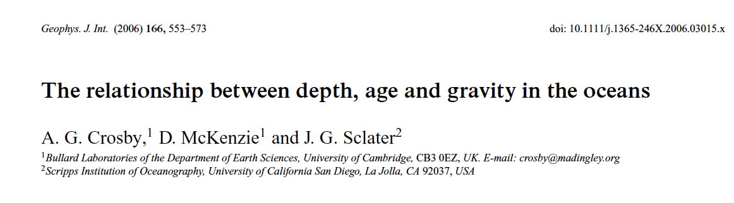
Notes:
The normal seafloor cooling process and relations between gravity and bathymetry do not set in under the plate is older than about 20-30 Myr and this is also about the age that
Non-MORB chemical signatures start to dominate over MORB signatures and that the LVA at 100 km depth starts to pinch out. We attribute this near-ridge zone to the presence of
the mainly passive ridge-feeding upwellings and the consequent along ridge flow. The boundary is fuzzy since there are also off-ridge upwellings that feed ridges laterally.

Slide 31
There is strong petrological, seismological and bathymetric evidence that there are no thermal anomalies associated with near-ridge hotspots (Niu and O’Hara; Presnell; Anderson; Melbourne and Helmberger), even at TZ depths. Some of these hotspots appear to associated with particularly pronounced and deep LVAs but even these have MORB-like compositions and temperatures.

Slide 32
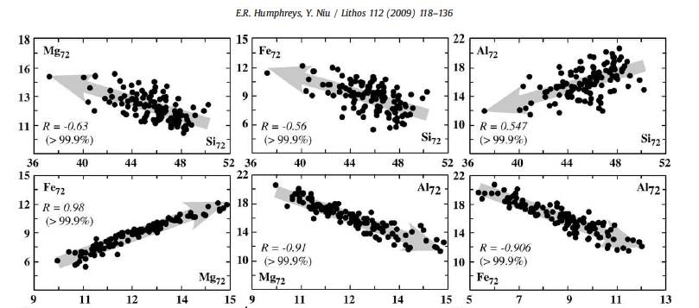
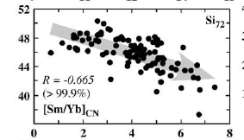
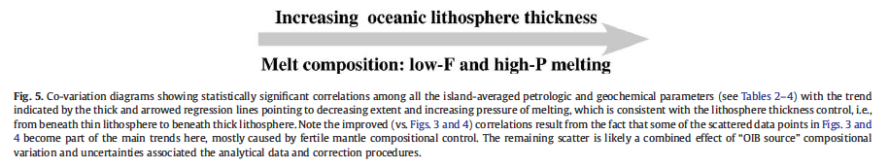

Slide 33
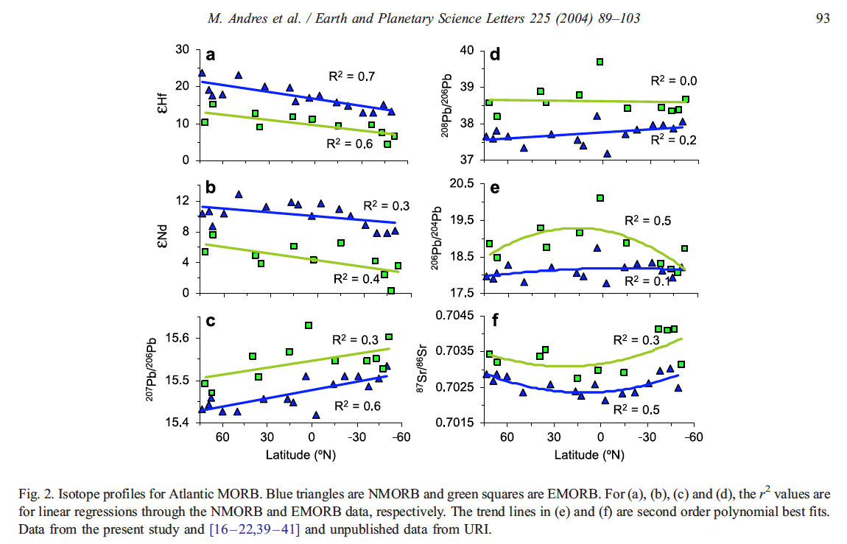

Slide 34
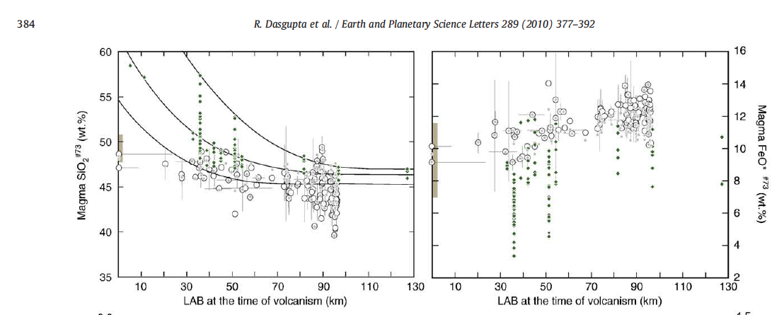
Notes:
MORB-like gone by 50 km

Slide 35
